Slide 1
An Ox
Anode is where oxidation takes place
Losing Electrons is Oxidation

Slide 2
Red Cat
Cathode is where reduction takes place
Gaining Electrons is Reduction

Slide 3
Cation
Positively charged ion

Slide 4
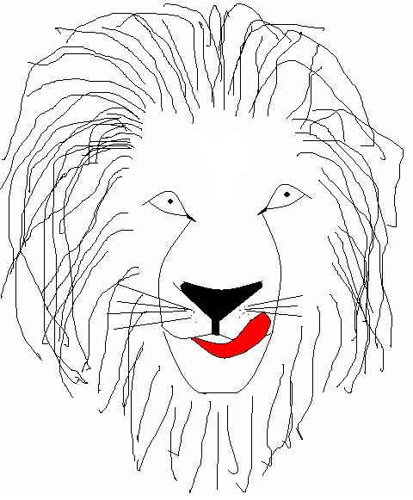
Leo the Lion
LEO the lion says GER or, for short, LEO GER

Slide 5
Anion
a negatively charged ion

Slide 6
This powerpoint was kindly donated to www.worldofteaching.com
http://www.worldofteaching.com is home to over a thousand powerpoints submitted by teachers. This is a completely free site and requires no registration. Please visit and I hope it will help in your teaching.

